Slide 1
CSC 362: System Programming
Lecture 16
Original slides by: Amitabha Dey
Adapted by: Dr. Richard Johnson
Department of Computer Science University of North Carolina at Greensboro

Slide 2

Status Check
Memory Fragmentation
Memory Placement Strategies
First Fit, Best Fit, Worst Fit, Buddy Allocation
Memory Coalescing & Memory Compaction
What we will cover today
Implicit Free List
Explicit Free List
Bidirectional Coalescing
Splitting and False Fragmentation
Boundary Tags
Free Block Insertion Policy - LIFO

Slide 3

Difficult Questions
Freeing: Given only a pointer, how much memory should be deallocated?
Free Block Organization: How do we efficiently track and manage free memory blocks?
Placement: Which free block should be selected to best fulfill a process's memory request?
Splitting: How should we handle the remaining portion of a free block after a partial allocation?
Coalescing: What steps should be taken when a block is freed to optimize memory usage?

Slide 4
Freeing memory blocks
Heap
Modern systems are byte-addressed.
Each memory address refers to one byte (8 bits).
A block is a group of bytes.
The heap (dynamic memory) is managed in blocks of memory, and the size of each block depends on the memory allocator.
Blocks are multiple bytes long, usually aligned to the system's word size (e.g., 4 bytes on a 32-bit system, 8 bytes on a 64-bit system).
allocated (4 words)
free
(3 words)
p1 = malloc (4) p2 = malloc (5) p3 = malloc (6) free (p2)
p4 = malloc (2)
What information does the allocator need to keep track of?
Notes:
Freeing Memory Blocks (Basics)
Modern systems are byte-addressed; each address is 1 byte.
The heap is managed in blocks, the size of which is determined by the allocator.
Blocks are usually aligned to the system's word size (e.g., 4 or 8 bytes).
Q. What information does the allocator need to keep track of?

Slide 5
Freeing memory blocks
Requires an extra word for every allocated block
free (p);
Keep the length of the block in the word preceding the block → header field or header
p0
Heap
payload
p0 = malloc (4)
block size
free (p0)
Notes:
Tracking Block Length
To know how much to free, allocators typically store the block length in a "header" word immediately preceding the payload.
This requires one extra word of overhead for every allocated block.

Slide 6
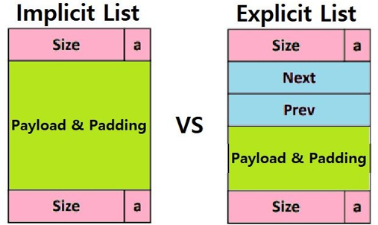
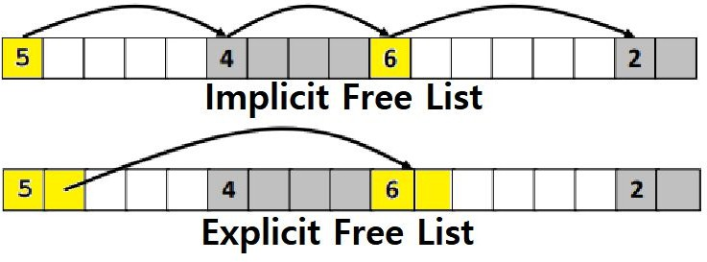
Keeping Track of Free Blocks
Image credit - https://velog.io/
Notes:
Implicit vs. Explicit Lists
Implicit List: Every block has a size/status header; the allocator must scan all blocks (allocated and free) sequentially.
Explicit List: Only free blocks are linked; free blocks contain pointers to the next and previous free blocks.

Slide 7
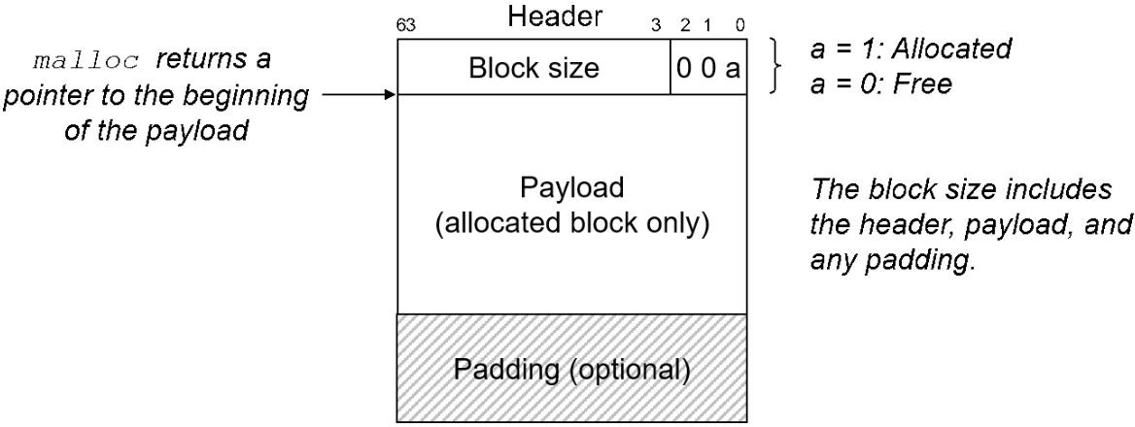
Implicit Free List
The implicit free list is a simple way to track free and allocated memory blocks in dynamic memory allocators.
Each block contains a header storing the size and allocation status.
The allocator traverses the heap sequentially when searching for free blocks.
Each block consists of:
Header: Contains metadata such as the size and allocation status.
Payload: The actual memory available for user allocation.
Optional Footer: Used for bidirectional coalescing
Image credit - https://awb.fyi/
Notes:
Implicit Free List Details
Simplest way to track memory.
Each block has a Header (size and allocation status) and a Payload (user data).
May include an optional Footer for bidirectional coalescing.

Slide 8
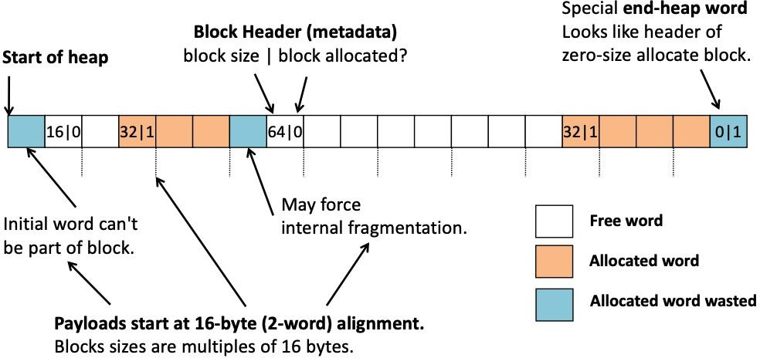
Implicit Free List
Implicit Free List: links all blocks.
For each block, we need size and allocation flag
→ 2 words - wasteful!
Image credit - https://awb.fyi/
Notes:
Implicit Free List (Wastefulness)
Linking all blocks means every block needs a size and allocation flag.
Using two separate words for this is considered wasteful.

Slide 9
Implicit Free List
Aligned Blocks
Memory alignment means the memory addresses for data structures are arranged to start at specific boundaries.
If memory blocks are aligned to 8 bytes, each block must start at an address that is a multiple of 8.
Image credit - https://awb.fyi/
Notes:
Memory Alignment
Data structures start at specific boundaries (e.g., 8-byte alignment).
If 8-byte aligned, every block address must be a multiple of 8.

Slide 10
Observation: (for 8-byte alignment)
Lower three bits are always 0.
Optimization:
Repurpose LSBs to carry allocation flag.
a = 0 (free)
a = 1 (allocated)
Masking:
When reading size, we must remember to mask out the least significant bit.
Using the lowest bit:
Instead of wasting an always-zero bit, it can be repurposed as a flag to indicate if a block is allocated or not.
Implicit Free List Optimization
base 2 (binary) | base 10 (decimal) | block position
0000 0000 0000 0000 | 0 | Start of Block 1
0000 0000 0000 1000 | 8 | Start of Block 2
0000 0000 0001 0000 | 16 | Start of Block 3
0000 0000 0010 0000 | 32 | Start of Block 4
Notes:
Implicit Free List Optimization
Observation: Due to alignment (e.g., 8-byte), the lower three bits of a block size are always zero.
Optimization: Repurpose the least significant bit (LSB) as an allocation flag (a=0 for free, a=1 for allocated).
Note: When reading the size, the allocator must mask out the LSB (least significant bit).

Slide 11
Implicit Free List
How would you fulfill p0 = malloc(3) request?
Notes:
Block size/status
4/0 (free)
4/1 (allocated)
6/0 (free)
2/1 (allocated)
0/1 terminator

Slide 12

Implicit Free List
splitting
If the fit is not good, an allocator might opt to split the free block into two parts
How much internal fragmentation are we willing to tolerate?
What happens if we now free p0?
Notes:
Splitting Blocks
If a free block is larger than needed, the allocator may split it into two parts: an allocated block and a remaining free block.
Decision factor: How much internal fragmentation is tolerable?
Splitting a free block:
A larger free block (6/0) is divided into a
4/1 allocated segment and a
2/0 free segment
to minimize internal fragmentation.

Slide 13

Implicit Free List
splitting
If the fit is not good, an allocator might opt to split the free block into two parts
How much internal fragmentation are we willing to tolerate?
free (p0)

Slide 14
Implicit Free List
splitting
How much internal fragmentation are we willing to tolerate?
free (p0)
Problem: If a process requests for 5 words, although we have enough, we cannot fulfill the request.
→ false fragmentation

Slide 15
Implicit Free List
adjacent free blocks cause false fragmentation—free memory chopped
up into many small unusable free blocks
to address this an allocator must merge
(coalesce) adjacent free blocks
splitting
immediate coalescing: merge blocks whenever one is freed
How much internal fragmentation are we willing to tolerate?
simple, constant time
can lead to a form of thrashing where a block is coaslesced and split repeatedly
free (p0)
deferred coalescing: wait and coaslesce at a later time (e.g., scan the list when a request fails)
often the more efficient choice
Problem: If a process requests for 5 words, although we have enough, we cannot fulfill the request.
→ false fragmentation
Notes:
Fragmentation & Coalescing
Adjacent free blocks can cause "false fragmentation,"
where the total free memory is enough for a request,
but the individual chopped-up blocks are too small.
Immediate Coalescing:
Merge blocks as soon as one is freed;
simple and prevents fragmentation build-up but can cause "thrashing" if blocks are immediately re-split.
Deferred Coalescing:
Delay merging until a request fails or a scan is triggered;
more efficient under heavy cycles but less predictable.

Slide 16


Immediate vs Deferred Coalescing
Deferred Coalescing
Immediate Coalescing
Coalescing is delayed, typically until:
A new allocation request fails.
A periodic or on-demand scan is triggered.
Pros:
Avoids unnecessary merges.
More control over when and how much to coalesce (can batch the work).
Reduces overhead during heavy allocation/deallocation cycles.
Cons:
Fragmentation can build up if not coalesced in time.
Searching and merging later could be more expensive (not constant time).
Less predictable performance.
Happens as soon as a block is freed.
Pros:
Constant time operation.
Prevents fragmentation from building up.
Predictable behavior (you know the state of free memory at any time).
Cons:
Can cause "thrashing": if a block is freed and immediately reallocated, it may be merged and split unnecessarily.
Wastes effort in merging when it might not be needed right away.
Potential cache disruption due to merging on every free.
Notes:
Thrashing occurs when a system spends more time moving data between storage and memory than executing instructions.
It can be defined as a severe performance breakdown where memory access patterns are so scattered or fragmented
that the system cannot combine them into efficient, single-memory transactions.

Slide 17



Implicit Free List
splitting
How much internal fragmentation are we willing to tolerate?
free (p0)
logical barrier
Solution: Memory Coalescing
Notes:
A logical barrier (often implemented via boundary tags) refers to
the structural separation maintained between contiguous memory blocks
that prevents the accidental merging of adjacent, but distinctly owned, free blocks,
while enabling the coalescing of truly contiguous free spaces.

Slide 18
Implicit Free List: Coalescing
Join (coalesce) with next/previous blocks, if they are free
Coalesce with next block → simple because of forward search
How do we coalesce with previous block?
How do we know where it starts?
How can we determine whether it is allocated?

Slide 19
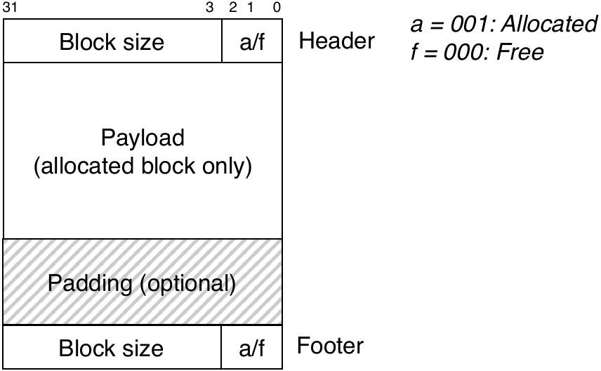
Implicit Free List: Bidirectional Coalescing
Boundary Tags (Footer)
Replicate header (size & allocation flag) at the bottom of the block → footer
Allows us to traverse the list backwards, but requires extra space
Together, the header and footer form boundary tags
If we go back one word from the header, we get to the footer of the previous block
Image credit - https://csit.kutztown.edu/
Notes:
Bidirectional Coalescing & Boundary Tags
Challenge: Coalescing with the next block is easy (forward search), but finding the previous block's start and status is difficult.
Solution: Replicate the header as a "footer" at the end of the block. Together, header and footer are "boundary tags," allowing the allocator to traverse memory both forward and backward.

Slide 20
Implicit Free List: Bidirectional Coalescing
Footer is used for easier navigation in some memory management schemes → The allocator can traverse memory blocks forward and backwards.
Image credit - https://csit.kutztown.edu/
Notes:
Bidirectional coalescing using headers and footers.

Slide 21
Implicit Free List: Bidirectional Coalescing
The problem with always using footers:
If blocks are very small, that extra footer adds
non-trivial overhead.
If many blocks are allocated at once, footers in every one of them wastes space needlessly — because we don’t use them until a block is freed.
Only free blocks get footers.
This is enough because:
When a block is freed, a footer is written.
When checking for coalescing, you only need the footer of a free previous block.
Image credit - https://csit.kutztown.edu/
Notes:
Footer Optimization
Always using footers is wasteful for small or allocated blocks.
Optimization:
Only free blocks require footers;
this is sufficient for a freed block to check its neighbors for merging.
---
For reference:
Q. How do we determine if the previous block is free if it might not contain a footer?
A.
The "Previous Allocated" Bit
The lower three bits of the header are used for status flags because block sizes are usually aligned to 8 or 16 bytes
(meaning the last 3 bits of the size are always zero).
Bit 0: Current block's status (1 for allocated, 0 for free).
Bit 1: Previous block's status (1 for allocated, 0 for free).
The Coalescing Logic
When you free the "Current Block,"
you check Bit 1 of its own header:
If Bit 1 is 1:
The previous block is still allocated. It has no footer,
but you don't need one because you cannot coalesce with an allocated block.
If Bit 1 is 0:
The previous block is free.
Because it is free, you are guaranteed that it does have a valid footer.
You can now safely look at the memory word immediately preceding your current header to read that footer,
determine the previous block's size,
and jump back to its header to merge them.
Why This Works
If the previous block is allocated,
its payload might indeed occupy the space where a footer would normally sit.
However, by checking the flag in the current block's header first,
the allocator knows never to look at that "garbage" data.

Slide 22
Explicit Free List
Currently we have to look at all blocks to find free blocks.
What if we could just look at free blocks?
In that case, the amount of time it takes for us to traverse through the free list will be proportional to number of freed blocks (not allocated + free blocks).
That’s where Explicit Free List comes in.
Uses a linked list of free blocks instead of scanning the entire heap.
Blocks maintain explicit next and previous pointers.
Notes:
Implicit lists: must scan all blocks to find free blocks.
(arrow down)
Q. What if we could just look at free blocks?
(arrow down)
A. Explicit Free List Advantages
Instead of scanning all blocks, the allocator only looks at free blocks.
Search time becomes proportional to the number of free blocks rather than total blocks.

Slide 23
Explicit Free List
The amount of time it takes for us to through the free list is proportional to the number of freed blocks rather than all (allocated + free blocks).

Slide 24
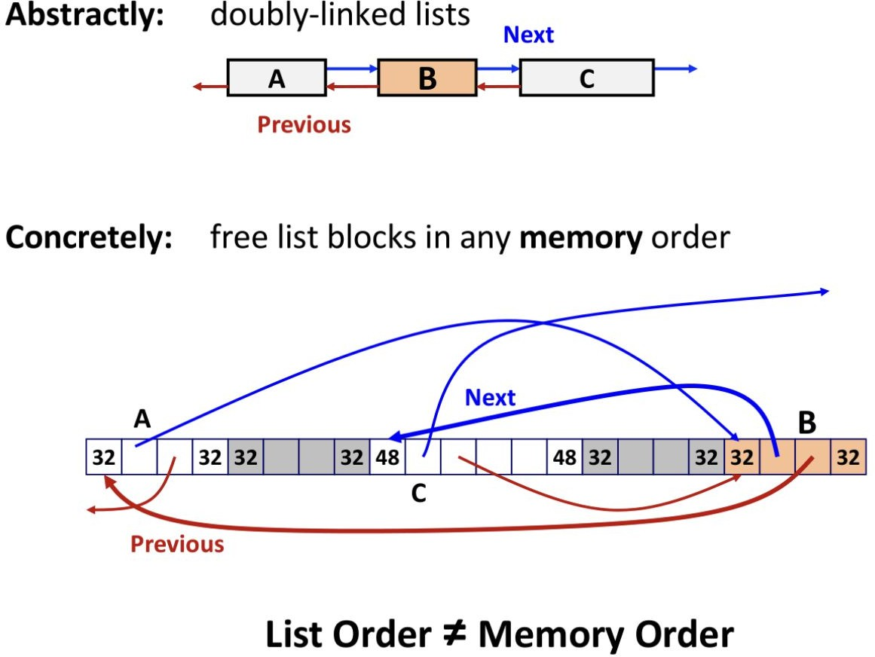
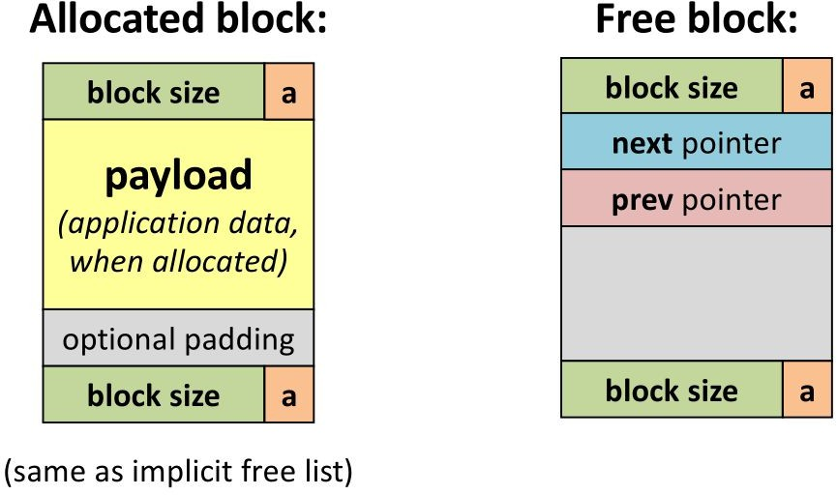
Explicit Free List
old payload
Image credit - https://awb.fyi/
Notes:
Figure 1:
A comparison of an allocated block versus a free block.
The free block diagram highlights the "old payload" area now housing explicit next and prev pointers,
used to navigate the free list without increasing memory overhead.
Figure 2:
"List Order ≠ Memory Order"
It shows an abstract doubly-linked list (A-B-C)
and its concrete implementation where pointers jump between non-contiguous memory addresses,
illustrating that free list logical order is independent of physical placement.

Slide 25
Explicit Free List
In the case of the Explicit Free List, from a logical point of view, it is a doubly linked list that is arranged in a straight line, but from a physical point of view, it is highly likely to have a jumbled connection relationship.
Why?
Because Free is not done in order. It is bound to get mixed up.
Notes:
Explicit Free List Structure
Logically a doubly linked list, but physically blocks may be scattered across memory.
Connection order is "jumbled" because memory is freed in random order.

Slide 26
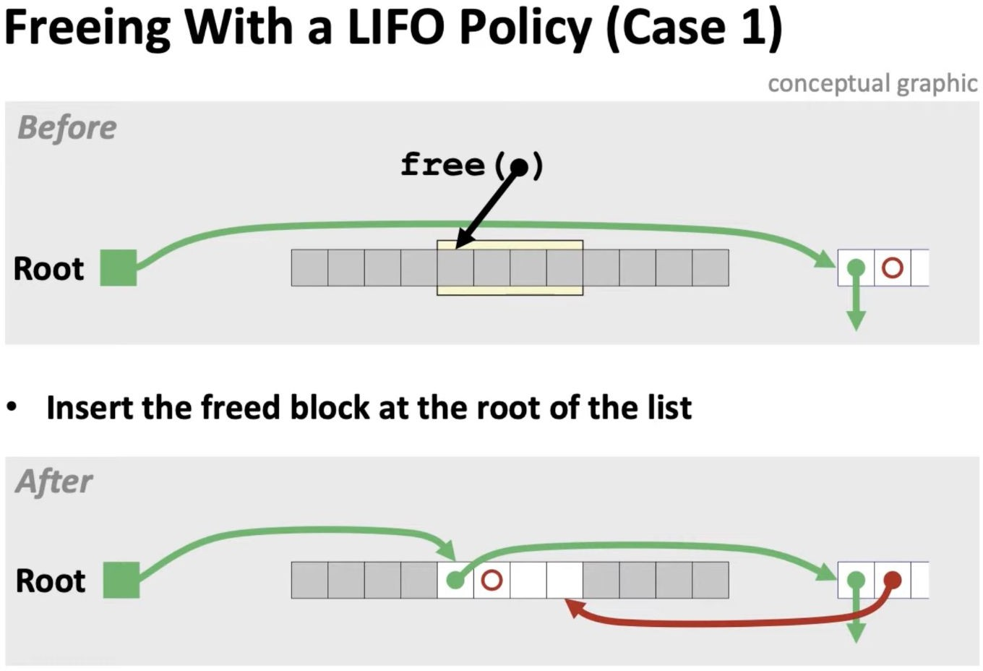
Case 1: No Coalescing Needed
Before: A block of memory is freed, and it’s not adjacent to any other free block.
Action: Simply add this free block to the front of the list.
After: The new free block is now at the
“root” of the free list
Notes:
Case 1 (No Coalescing):
Newly freed block is inserted at the root of the list,
with pointers updated to make it the first element in the sequence.

Slide 27
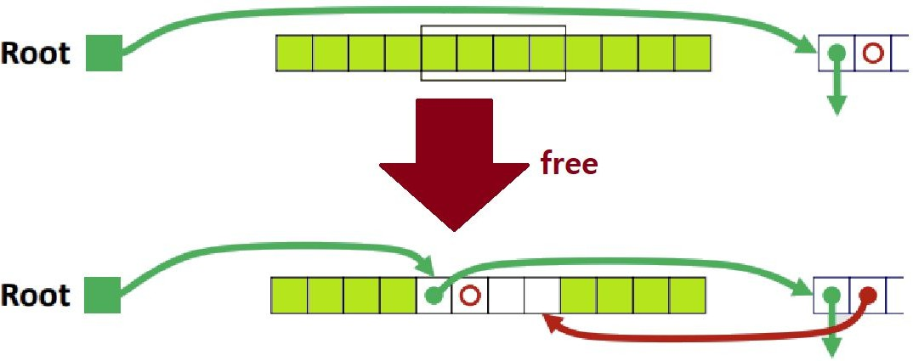
Case 1: No Coalescing Needed
When trying to Free an Allocated Block, both Previous & Next Blocks are Allocated.
Simply perform a Doubly Link between the Root (Head) and the 'Newly Freed Block', the 'Newly Freed Block' and the 'Previous First Free Block'.
Notes:
Case 1: No Coalescing Needed
Condition:
An allocated block is being freed, but both its immediate physical neighbors (Previous & Next) are currently allocated.
Action:
No merging occurs because there are no adjacent free blocks.
The newly freed block is simply added to the front of the Free List.
Linking:
Create a double link between the Root (Head) and the newly freed block,
and between the newly freed block and the old "First Free Block."

Slide 28
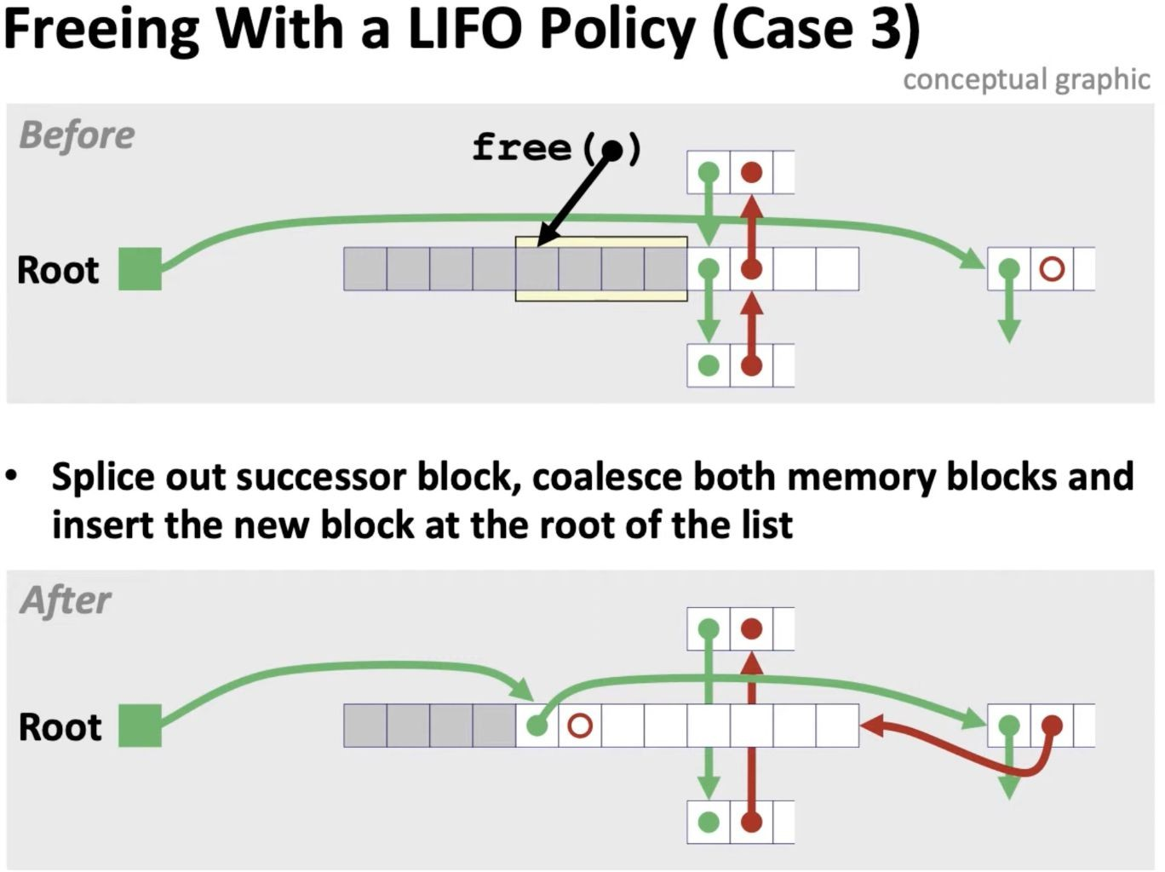
Case 2: Coalescing With The Next Block
2)
Before: A block is freed, and the block after it (in memory) is also free.
Action: Remove the next block from the list, merge to form a larger block and put it on front of the list.
After: The coalesced block is the new
“root”
Notes:
Case 2 (Next Block Free):
Splicing of a successor block and
the subsequent coalescence into a new free block positioned at the list root.

Slide 29
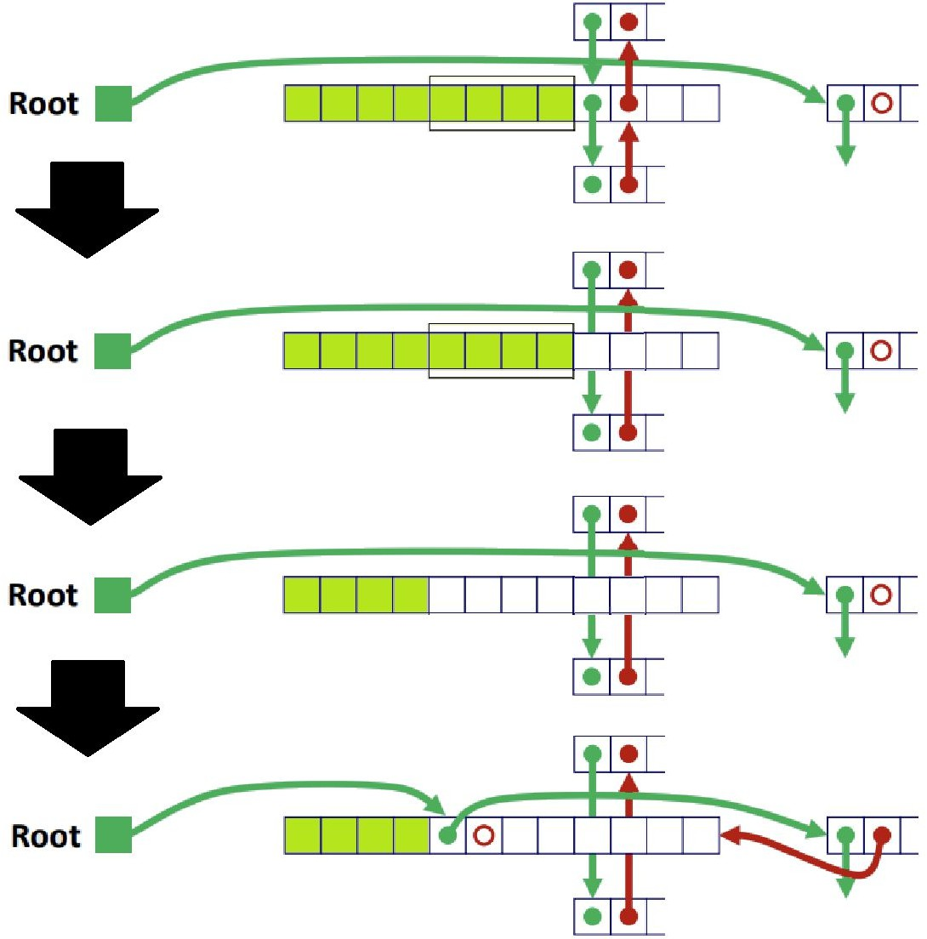
Case 2: Coalescing With The Next Block
Trying to free an allocated block, but the next block is free
First, let's start with Coalescing.
To do this, first Splice Out the Next Block from the Free List , that is, eject it.
Next, the evicted block and the Newly Freed Block are merged into one → Using Boundary Tags.
After coalescing is complete, the newly created Coalesced Free Block is inserted at the very front of the Free List!
You can see that it first deletes the Next Free Block from the Free List, then merges that Block with the new Free Block, and then inserts them back into the Free List. Instead, to the very front!
Notes:
Coalescing With The Next Block
Condition:
An allocated block is being freed, and its physically subsequent (Next) block is already free.
Action:
Splice Out: The existing free block is removed (ejected) from the Free List first.
Merge: The newly freed block and the ejected block are joined into one larger block using Boundary Tags.
Re-insert: The new, larger coalesced block is inserted at the very front of the Free List.

Slide 30
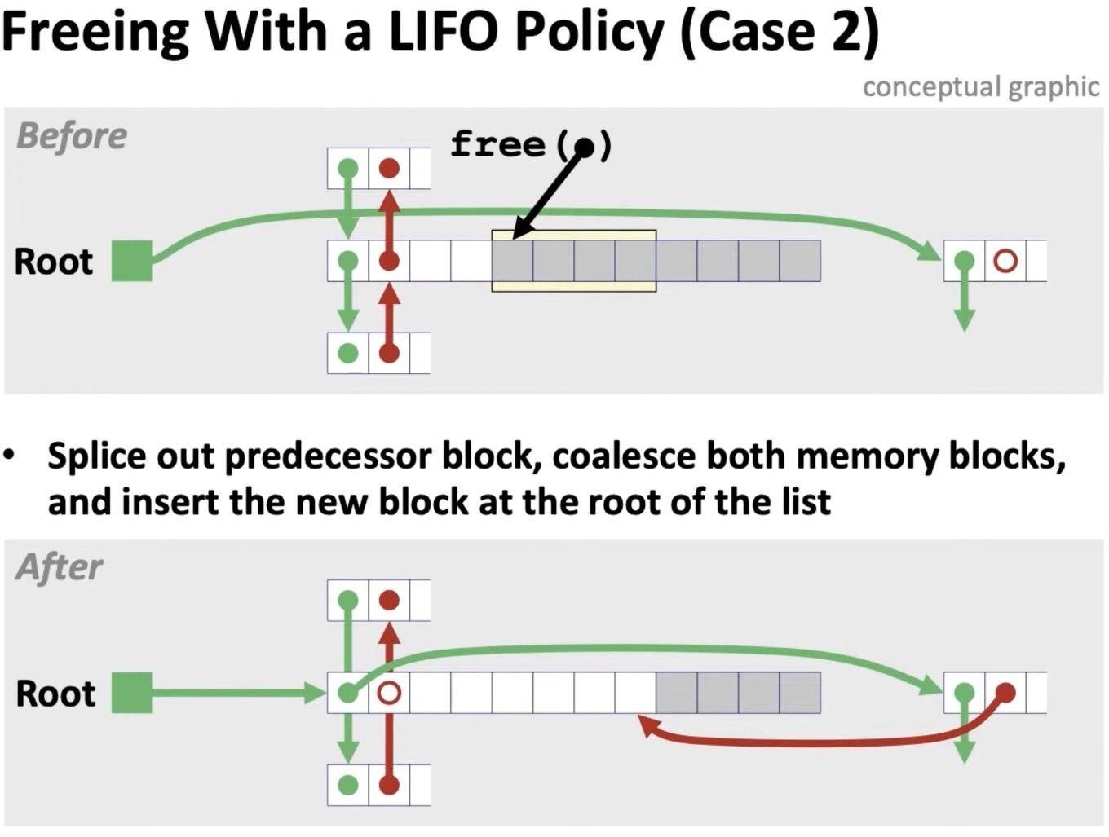
Case 3: Coalescing With The Previous Block
Same as Case 2
3)
Before: A block is freed, and the block before it (in memory) is also free.
Action: Remove the previous block from the list, merge to form a larger block and put it on front of the list.
After: The coalesced block is the new
“root”
Notes:
Case 3 (Previous Block Free):
A block is freed adjacent to a predecessor free block.
The two are coalesced into a single larger block and then moved to the root of the list.
Action:
Splice Out: The existing free block is removed (ejected) from the Free List first.
Merge: The newly freed block and the ejected block are joined into one larger block using Boundary Tags.
Re-insert: The new, larger coalesced block is inserted at the very front of the Free List.

Slide 31
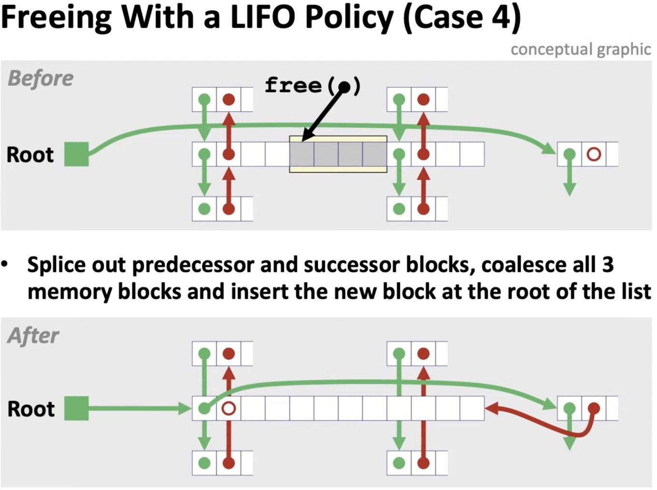
Case 4: Coalescing With Both Adjacent Blocks
Before: The freed block is between two free blocks.
Action: Coalesce and combine both the previous and next blocks to form a larger single block.
Action: The larger, coalesced block is now at the front of the list.
Notes:
Case 4 (Both Adjacent Free):
A block is freed between two existing free blocks.
All three are coalesced into one large block, which is then linked at the root of the free list.

Slide 32
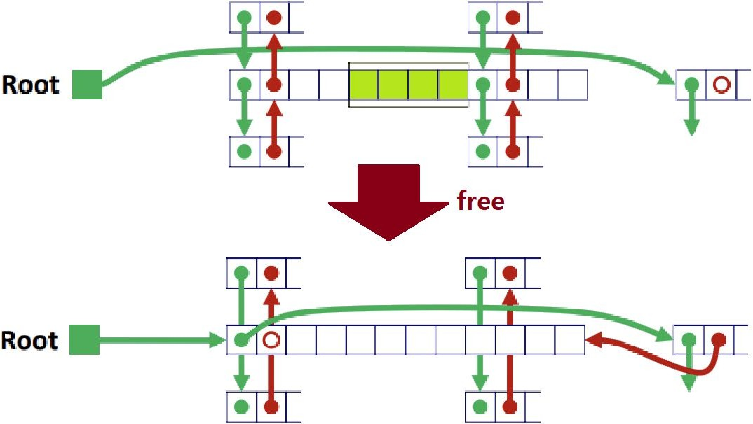
Case 4: Coalescing With Both Adjacent Blocks
This is also the same as Case 2. Both the Previous Free Block and the Next Free Block are extracted from the Free List, and then they and the Newly Freed Block are combined into one Free Block.
That is, a total of three Memory Blocks are subject to Coalescing.
Next, insert them at the very front of the Free List .
Notes:
Case 4: Coalescing With Both Adjacent Blocks
Condition:
An allocated block is being freed, and both its physical neighbors (Previous & Next) are already free.
Action:
Extraction: Both the Previous and Next free blocks are "spliced out" from the Free List.
Triple Merge: All three blocks (Previous + Newly Freed + Next) are combined into a single, large continuous free block.
Re-insert: This single large block is then placed at the front of the Free List.

Slide 33

Important Readings
https://awb.fyi/courses/cs208/s22/notes/free-lists.html
https://csit.kutztown.edu/~schwesin/fall20/csc235/lectures/ Dynamic_Memory_Allocation_Basic.html
https://velog.io/@junttang/SP-6.3-Explicit-Segregated-Free- List
https://www2.lawrence.edu/fast/GREGGJ/CMSC480/malloc
/malloc.html
Prof. Luis Ceze Part 1: https://www.youtube.com/watch?v=74s0m4YoHgM
Prof. Luis Ceze Part 2: https://www.youtube.com/watch?v=rhLk2lf6QXA
Prof. Chris Kanich: https://youtu.be/UTii4dyhR5c?feature=shared

